Slide 1
Sightsavers economic empowerment portfolio
IDDC May 2024

Slide 2
Sightsavers EE presence
Pakistan
Senegal
Nigeria
Uganda
Kenya
Ghana
Tanzania
Cote d'Ivoire
Malawi
Zimbabwe
Mozambique
Zambia
Where we have economic empowerment programmes
Notes:
Scaling our EE portfolio since 2018, currently implementing across 12 countries, plus India which is implemented and managed by Sightsavers India

Slide 3
Sightsavers economic empowerment portfolio
Donors include UK-Aid, USAID, Futuremakers by Standard Chartered, European Commission, GIZ/BMZ and Sightsavers seed funding
Key principles: informed by labour market assessments, co-created and delivered in partnership with OPD’s, and a commitment to increasing participation of underrepresented groups
Leveraging the model, relationships and lessons learned from UK-Aid funded Inclusion Works programme
Public-private partnerships: institutional investment catalysing private sector contributions and commitments
Notes:
SS portfolio in EE – focus ppt on PPP and value chains. Some areas of programming aren’t captured (e.g micro-enterprise development)

Slide 4
Private sector partnerships and waged employment
Building the employability and job readiness of women and men with disabilities (training, mentorship, support)
ILO and business disability networks – convening platforms for peer learning and championing best practice (Nigeria, Kenya, Pakistan, Ghana, Zambia, Zimbabwe, Tanzania)
Employer pathway – building employer confidence and practice as a core element of programming
Piloting new approaches for digital skills: GIZ/UK-aid/SCF funded IT Academies in Kenya and Nigeria with Safaricom and MTN
Notes:
Looking to see where we can work with private in depth and the opportunities that a value chain approach opens up – strengthening inclusion in the core business (workplace operations) as well as embedding throughout value chains and leveraging corporate influence across clients and service providers/suppliers

Slide 5
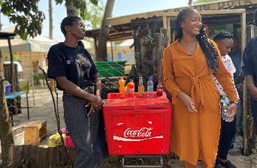
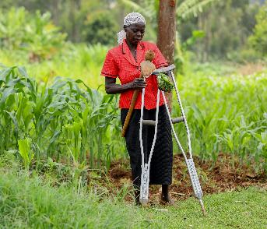
Inclusive value chains: self-employment and entrepreneurship
Retail value chains with Coca Cola Beverages Africa, Unilever and Diageo
Sorghum farming supply chains with Diageo
Supported through specialist technical partnerships on business development/agronomic advice
Leveraging private sector contributions through donor investments
Notes:
We have partnered with CCBA to support women with disabilities into the retail distribution channel of CCBA value chain, this partnership with CCBA is currently delivered under the USAID Global Labor Program with Technoserve providing business development advisory support and coaching to businesses owned by women with disabilities. Also looking to replicate this outside of Kenya with cost share contributions from CCBA markets.
We are also partnering with Diageo/Guinness and Unilever in Nigeria through their Plan W programme, on a similar initiative for women with disabilities as retailers.
Essential support provided by specialist technical partners – BDS and agronomy, building those into projects and supporting them on inclusion
We have been partnering with Diageo for the last 5 years, starting with a small pilot in Kenya to enrol farmers with disabilities into the sorghum value chain which is now scaled to reach over 1400 farmers with disabilities through the Global Labor Program. We’re now replicating the model in Tanzania with co-funding from Diageo, and in discussions on how to scale this across Diageo markets as they embed inclusion within their smallholder sourcing strategy. Our farming value chains work is delivered in partnership with the Syngenta foundation for sustainable agriculture using their farmer hub model.

Slide 6
Thank you!
https://www.sightsavers.org/disability-and-inclusion/employment/

