Slide 1
HelpAge International – Ageing, disability and social protection
IDDC workshop, Brighton, 16 May 2024
Federica Foiadelli, Advocacy Adviser - Income and Food Security

Slide 2
Outline
HelpAge International
Disability in older age
Older people's income security
Age- and disability-inclusive social protection
Our work with Older People's Associations

Slide 3
HelpAge International
HelpAge International is an international NGO with a unique focus on older people’s rights, dignity and wellbeing
We coordinate a global network of organisations standing up for the rights of older people, with 170+ members across 93 countries
We are committed to locally-led development and partner-led programming

Slide 4
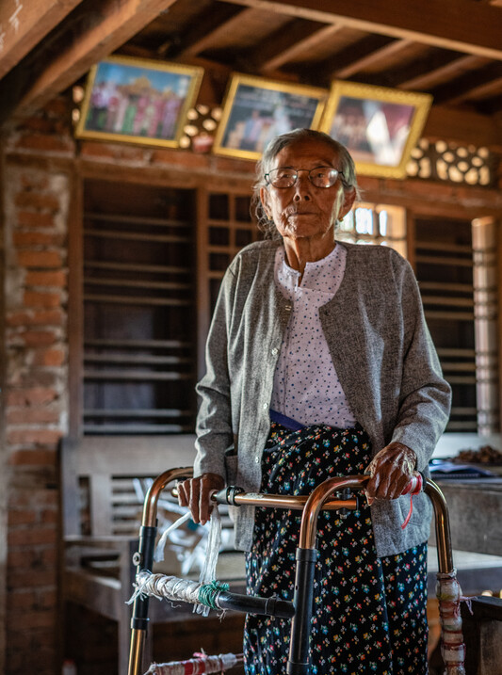
Disability in older age
Growing population of older people in absolute and relative terms - about 1 billion people aged over 60 in 2020, expected to double by 2050 (WHO)
More than 46% of older people are living with a disability, with a diversity of experiences (UNDESA)
Older people with disabilities face physical, social and attitudinal barriers to their participation and inclusion and may encounter double discrimination (age and disability)
We know that older women with disabilities are at particular risk of violence, abuse and neglect (UN Women)

Slide 5
Older people's income security
Older people’s income security rests on a mix of often inadequate income sources (work, pensions, support from family, savings and assets)
Social pensions play a critical role, but coverage and adequacy are limited, incl. gender gaps, despite ca. 78% of older people globally receiving a pension (ILO)
Social pensions and disability benefits are often mutually exclusive and disability benefits are not widespread enough
While paid work declines significantly in older age, it remains an important source of income
Alongside discrimination and family responsibilities, disability has a major influence on the ability to work
Demographic change is likely to heighten further the risks of experiencing income insecurity in old age

Slide 6
Age- and disability-inclusive social protection
Social protection systems are a key to ensure that older people with disabilities can maintain their autonomy and live a life in dignity.
Key components of age- and disability-inclusive social protection systems:
FUNCTION 1:
GENERAL INCOME SECURITY
E.g., Universal social pensions that are age, gender and disability responsive (design and implementation)
FUNCTION 2:
COVERAGE OF DISABILITY-RELATED COSTS, INCLUDING SUPPORT SERVICES
E.g., Disability insurance, disability allowance compatible with work and other income support, concessions, personal assistance schemes
FUNCTION 3:
HEALTHCARE
Disability-related medical care, rehabilitation and assistive technologies

Slide 7
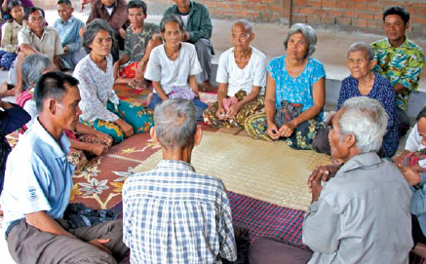
Our work with Older People's Associations
HelpAge International is supporting the development of Older People’s Associations (OPAs)
Older people’s associations (OPAs) are multifunctional innovative community-based organisations of older people, aimed at improving older people’s living conditions and developing their communities
On average, 15% of OPA members tend to be older people with disabilities (HelpAge)
In many countries, OPAs are the largest source of community-based care for older people with disabilities
Some OPAs also focus on ‘rights and entitlements’ and provide direct support to members on access to old age, disability and widow allowances

Slide 8
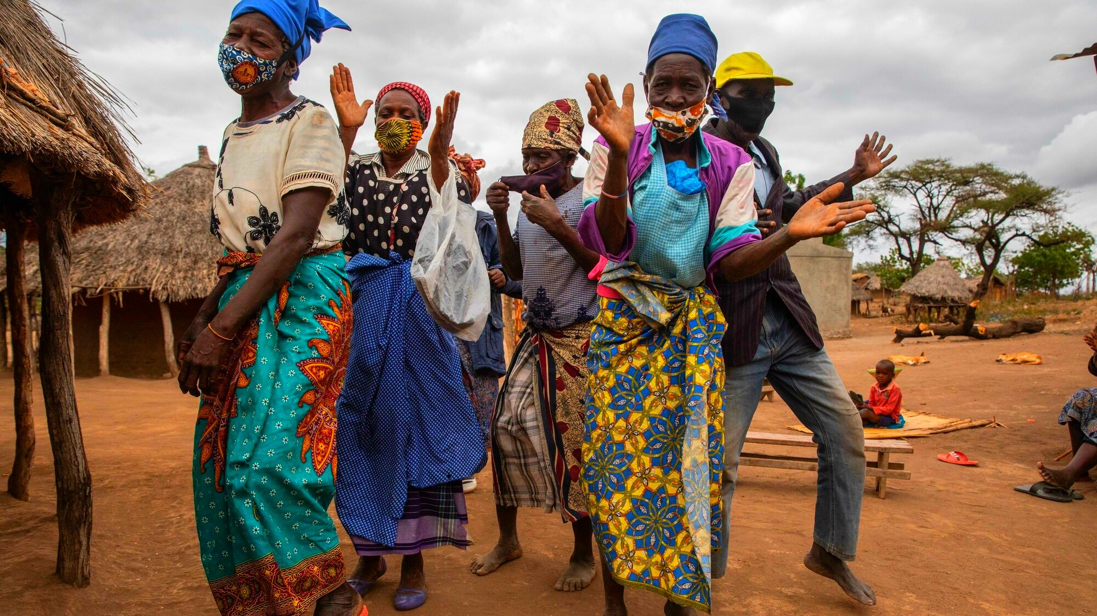
Thank you!
www.helpage.org
HelpAgeInternational
@HelpAge

