Slide 1
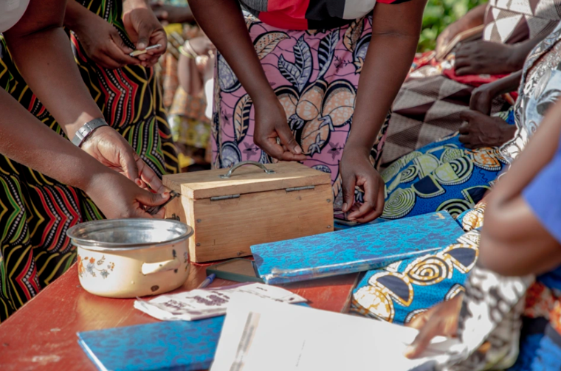

Promoting community based Savings Groups
CBM/LUC
IDDC Economic Empowerment Workshop
Financial services inclusion and social protection
Brighton, 16 May 2024
Jim Cannon Global Livelihood Advisor

Slide 2
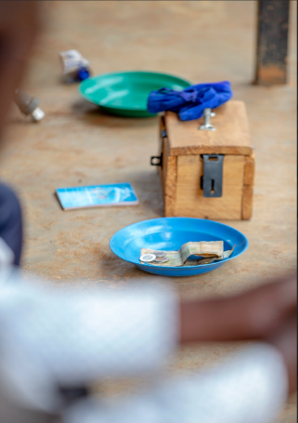
What is a Saving Group
Savings Group
Enables persons with and without disabilities to increase access to and control over financial resources
Build skills, assets and competencies, enhances participation
Trust based informal savings and lending groups
Promotes financial inclusion and economic empowerment
CBM/LUC

Slide 3
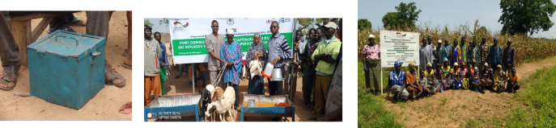
Leveraging Community Based Savings Groups (SGs)
SGs are a pillar of CBMs Livelihoods and Economic Empowerment approach
    SGs + financial literacy
    Business and technical skills
    Disability inclusive

Slide 4
Leveraging Community Based Savings Groups (SGs)
In 2023, CBM supported 30,794 members of SGs (of a total of 34,932 persons accessing informal microcredit)
In 2023 - SGs supported 43 % persons with disability, SG membership 64% women
CBM recognizes the social protection role of SGs for members and linkage to other support programs

Slide 5
CBM work with Savings Groups
2024
CBM is piloting SG in emergency based context in Cameroon
2023
16 CBM Country programmes implementing - disability specific or inclusive SGs. 21 promoting access to informal microcredit
2018
CBM Disability Inclusive SG technical guidance developed
2017
Broader country programme roll out, SG promotion and scaling larger projects (Uganda, Ethiopia, Kenya)
2016
Rwanda first CBM SG pilot and most successful SG programme

Slide 6
Why Savings Groups 1 ?
  Groups are low-cost, simple to manage and act as critical first step in financial inclusion
Reach and serve some of the poorest communities in the most remote locations
  Raise the self-respect of individual members and help to build up social capital within communities

Slide 7
Why Savings Groups 2 ?
  Maintain a social fund to support members in times of need (funeral expenses, medical costs, school fees, food)
  Well-embedded in their communities + engage in activities which benefit the wider community
  Membership leads to increased income, access to education, and self-reliance

Slide 8
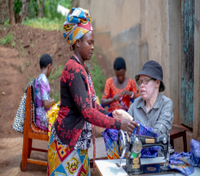

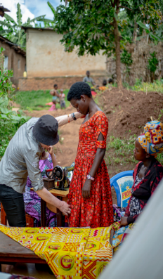
Savings Groups and Social Protection 1
Savings Groups are increasingly promoted as a graduation pathway to support beneficiaries of national safety nets to save, build resilience, access formal financial services
In Rwanda, the impact of SGs goes beyond financial and economic empowerment. SGs supported by CBM Rwanda partner NUDOR (National Union of Disability Organisations in Rwanda)
©CBM/LUC

Slide 9
Savings Groups and Social Protection 2
Connecting SGs to SACCOS, business support and grants, agricultural extension services, access to land for collective farming activities and market linkages.
Social Cash Transfer and Public Works Programmes – like the Vision Umurenge Programme
©CBM/LUC

Slide 10
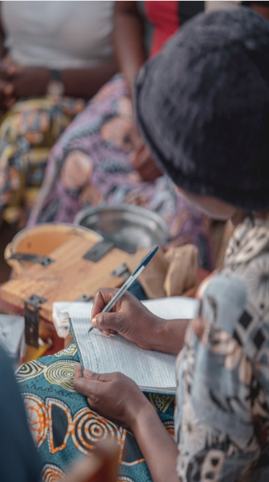
Lessons learned 1
Simple and transparent
Self sustaining after initial training
Does not require external funding
Gender sensitive - safe and friendly spaces are good places to nurture livelihood and social activities
©CBM/LUC

Slide 11
Lessons learned 2
Ideal tool for financial inclusion of persons with disabilities and ultra poor persons
On-going training and capacity building of groups in entrepreneurship, group strengthening essential for success
Ensure support and engagement of local authorities
©CBM/LUC

Slide 12

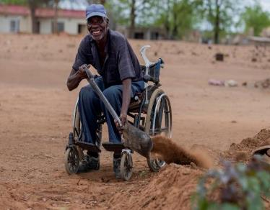
CBM India

